Slide 1
Working collaboratively with Git
James Whale, Data Engineer

Slide 2
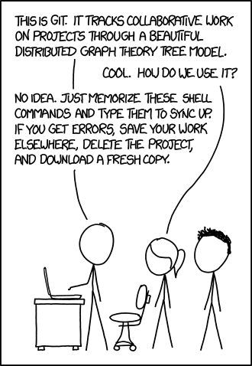
What is Git?

Slide 3
What are the problems of multiple developers working together on the same code?
How do two developers work on the same file at the same time?
How do you control who can make changes?
How do we know who made changes and why ?
How do we can make sure we can properly test our code before releasing a new version?

Slide 4
How does git allow us to work together?
Git can help us solve these problems using the following:
Branching
Commit messages
Pull Requests

Slide 5
Branches
What are branches?
A branch is an independent instance of the code base
Branches allow multiple developers to work on the same code without overwriting each other
Five main types of branch:
Master branch
Develop branch
Feature branches
Release branches
Hotfix branches

Slide 6
How we use branches at Kobalt
Hotfix
Master
Release
Develop
Feature
Feature

Slide 7
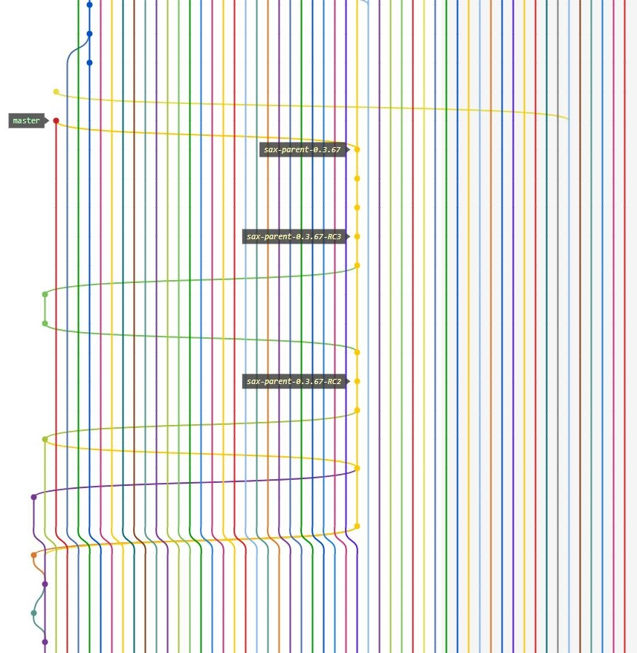

Slide 8
Commits and commit messages
Once I’ve completed the feature I want to commit my code
A commit is the code I’m going to change to complete a feature
I write a commit message explaining what I changed and why
Once you have made a commit don’t forget to push it to the remote repository

Slide 9
Useful Commit tips
Commit messages should be meaningful
They should describe why you made the change you did
They should not be vague e.g. ‘changes’
The purpose of a commit message is so that in the future someone can look back and understand why you made the change did
Often this will be yourself, and it you can’t understand why you made the change, what chance does someone else have?
This is you signing your signature on your code

Slide 10
The dreaded merge conflict
A merge conflict is when the same line of code is different on the two branches you are merging
This can happen when two developers are working on the same file and they both add a new method to the bottom of a file
How do I fix it?
On your branch, pull the other developers changes from the remote branch
This will mix their code to yours – so this can look really messy and confusing
Manually fix the conflict by choosing the right code
Don’t forget to then commit and push your commit again

Slide 11
Pull Requests
Before making a pull requests:
Make sure your build passes
Check your code compiles
Check you have fully implemented the feature
Pull requests are either approved or rejected (meaning they need more work)
Once approved they can be merged into the target branch
This is when you might get a merge conflict

Slide 12
Pull requests best practices
Discuss if this is the right solution/approach as a team
Pull requests are not personal!
We’re all working together to make a good product with code that we can all proud of
The whole team reviews each others pull requests
Everyone can make comments and suggestions no matter how junior or senior you are
When reviewing pull requests please be helpful and constructive!

Slide 13
Questions?

Slide 14
Workshop
Go to https://github.com/jameswhale/git-introduction/
Work through Working collaboratively with git.md
Ask myself or Alison questions about it or anything else

